Slide 1
SG8002 Lesson 3: Sentence Stress, Rhythm And Intonation, Chunking & Comparison and Contrast
Semester A 2021-2022

Slide 2
Last lesson
This lesson
Review of IPA (Vowels and Consonants)
The importance of accurate Word Stress
Teaching Strategy 1: Definition and classification
Presentation Skills: Smiling, Stress, Hand Gestures and Signposting
Mini-teaching Demonstration (1) using Definition and Classification
Introduction to OPTIMUS website
Any questions/comments?
Quick revision of word stress
Revision of Teaching Strategy 1: Definition and Classification
Revision of Presentation Skills: Smiling, Stress, Hand Gestures and Signposting
Introduction to Sentence Stress, Rhythm and Intonation
Introduction to Chunking
Teaching Strategy 2: Comparison and Contrast
Teach a 3-minute Compare and Contrast mini-lesson
Homework explanation

Slide 3


Slide 4
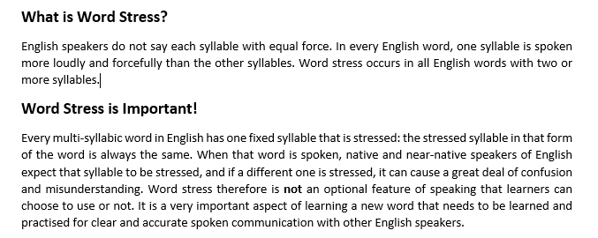

Slide 5
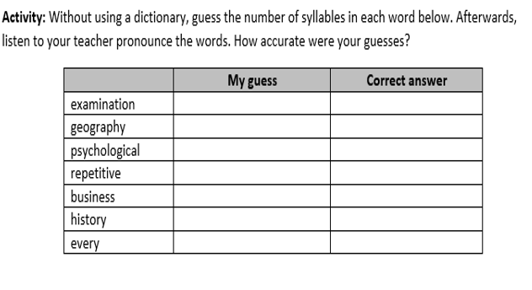
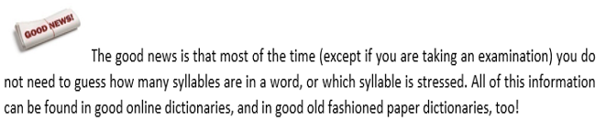

Slide 6
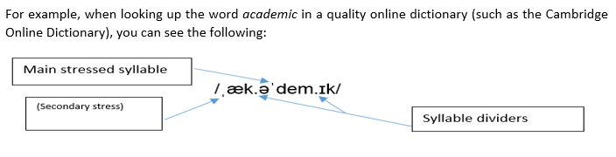
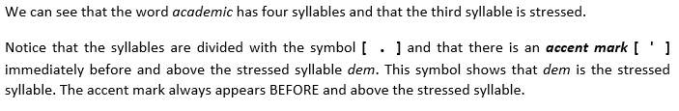

Slide 7
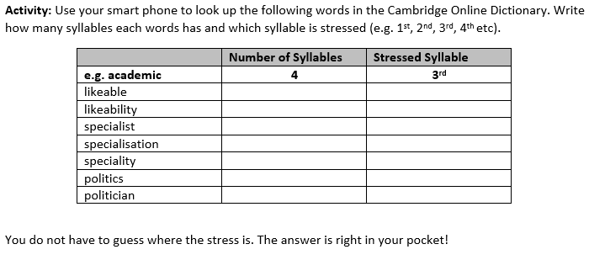

Slide 8
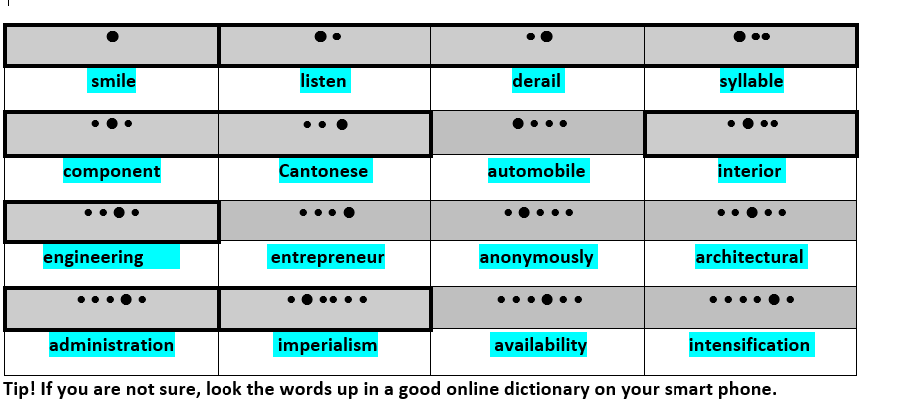

Slide 9
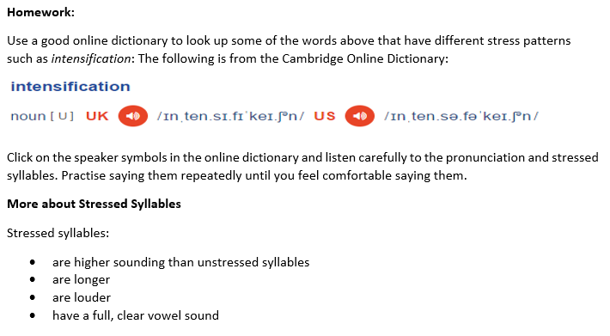

Slide 10
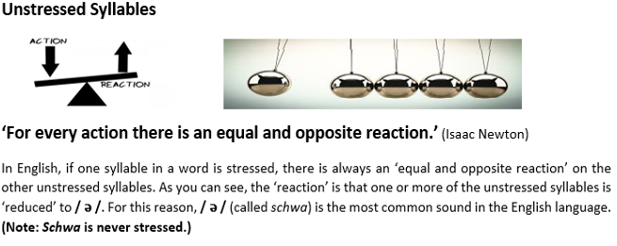
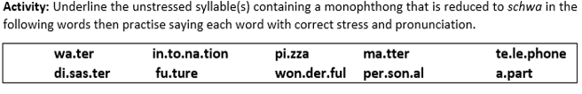
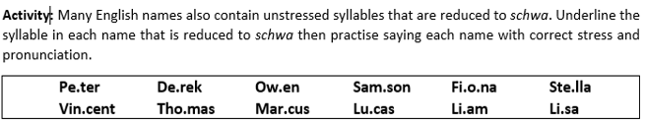
Let’s Practise!

Slide 11
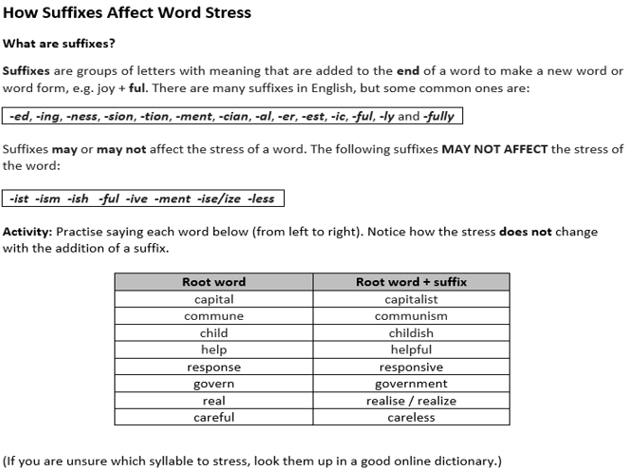

Slide 12

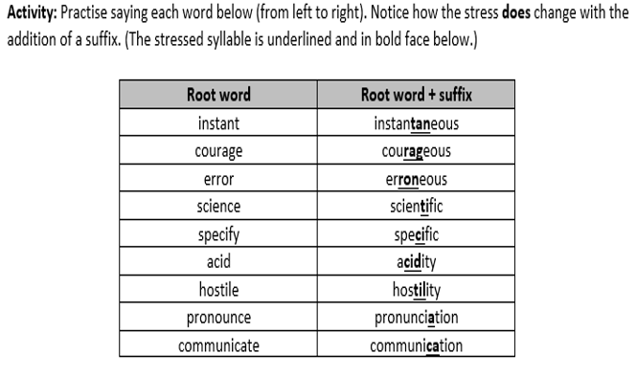

Slide 13

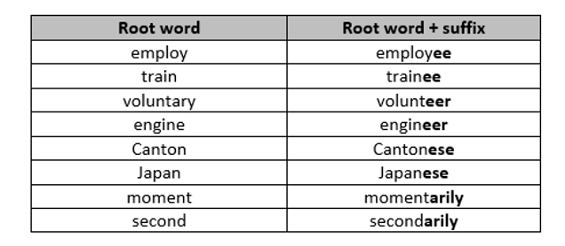
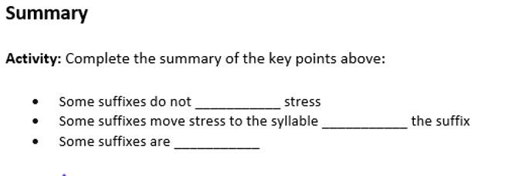
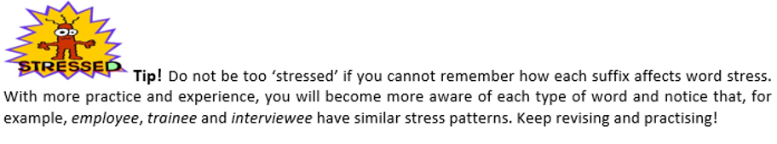
Activity: Practise saying each word below (from left to right). Notice how the suffix is stressed.

Slide 14
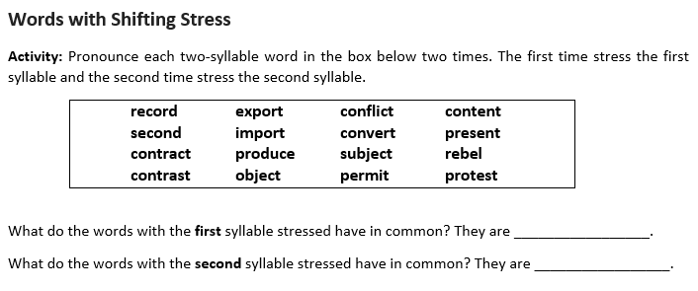

Slide 15
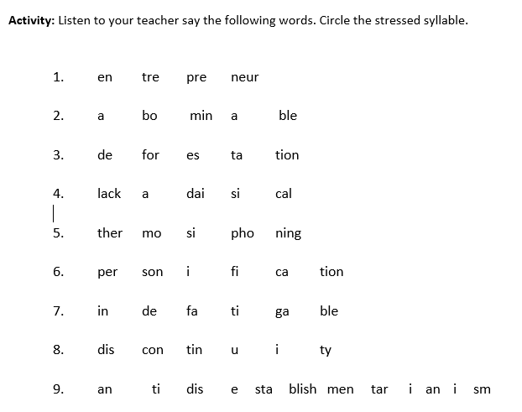

Slide 16


Teaching Strategy 2:
Definition and Classification

Slide 17
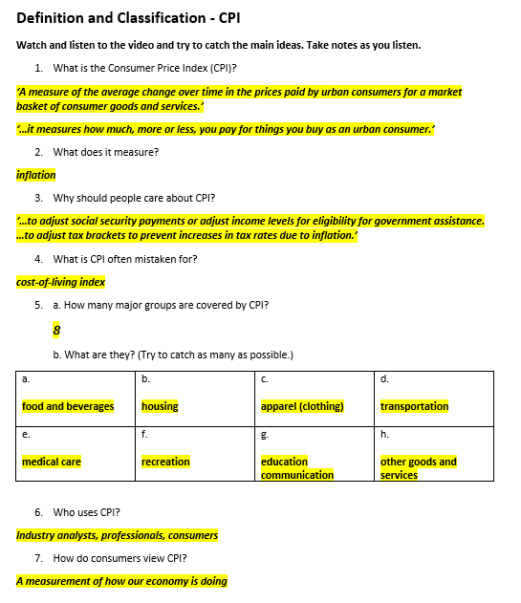

Slide 18

Signposting
One strategy good presenters use to make their talks easy to follow is signposting. In presentations, lecturing and teaching, signposts have the same function as they do on the street – they provide direction. In a presentation, signpost words and phrases tell the audience the direction the presentation will take and the sequence of the content that will be discussed. In short, signposting guides the audience through the presentation. As you can see below, signpost phrases have different functions.
‘Today I’d like to talk to you about…’
‘The second point I’d like to discuss today is…’
‘Now, let’s summarise the main points of what we discussed today. First,…’
‘This talk will be divided into three sections, first…’

Slide 19
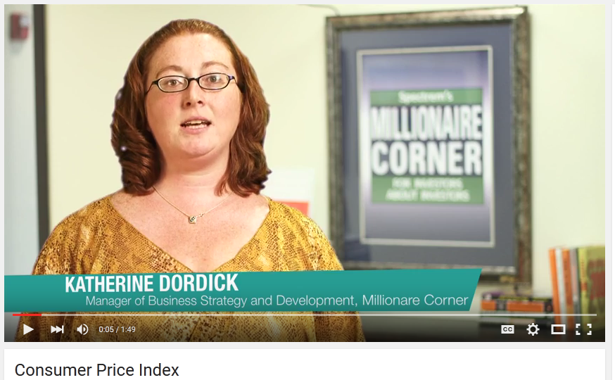
Video 1 - Definition and Classification: Consumer Price Index (CPI)
https://www.youtube.com/watch?v=5nQPm_diIzQ
CPI is defined by the Bureau of Labor Statistics as a measure of the average change over time in the prices paid by urban consumers for a market basket of consumer goods and services. Now, what does that mean? That means, that it measures how much, more or less, you pay for things you buy as an urban consumer. Now why should you care? CPI is usually used as an inflation measurement. This figure is often used to adjust social security payments or adjust income levels for eligibility for government assistance. CPI is also used to adjust our nation’s tax brackets to hopefully prevent increases in tax rates due to inflation. CPI is not a cost-of-living index, however, as it is often mistaken for. The cost of living index would need to go far beyond the scope of the information provided in the CPI data. There are eight major groups that CPI covers: food and beverages; housing; apparel; transportation; medical care; recreation; education and communication; and other goods and services, such as tobacco products, haircuts, etc. CPI is used by many industry analysts and professionals in a wide variety of ways. But for many consumers, it is viewed as a measurement of how our economy is doing. As well as seeing or not seeing a change in their social security income, military income, civil service, retirement income, or many other income adjustments.
For more video educational material, news, information, or resources, please visit our website at www.millionairecorner.com. Thanks for watching.
Definition
Signposting
Uses
Limitations
Classification / categories
Signposting

Slide 20
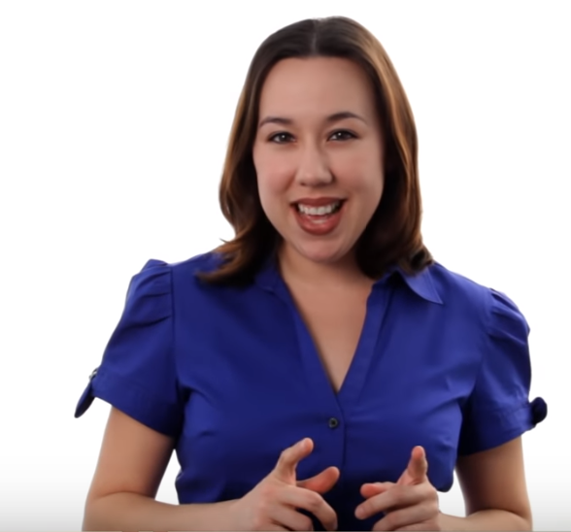
Video 2: Definition and classification
Watch this Definition and Classification video…
https://www.youtube.com/watch?v=EPfzJ9qaPcw
…and think about the structure and language of the talk.

Slide 21
Hi. My name is Mary Poffenroth. I’m an adjunct professor of Biology and today we are going to talk about biodiversity. First let’s start by breaking up the word. Now, the first part, bio. That means life. The second part, diversity, that means differences. So think about the diversity in humans, how we’ll all very different. Now if you put those two words together you’re talking about the differences of life. Now high biodiversity, or having lots of biodiversity, is always a good thing. Let’s talk about the three different types of biodiversity. We’re going to go from smallest to largest. First, genetic diversity. Genetic diversity is important within a species or a population because that’s going to give that species the greatest chance of survival. When you have high genetic diversity, you’re just going to have more genes in that gene pool available to deal with environmental changes. Now let’s move to the middle one, species diversity. Now species diversity is going to be the different types of species you have in an ecosystem. However, you’re talking about, let’s say, a tropical rain forest, you're going to have huge, high species diversity. That means that ecosystem is doing well. But, even if you talk about a desert that diversity is going to be a little bit lower but you still want high species diversity that’s relative to that desert. And lastly, our largest type of biodiversity is ecosystem diversity. On the planet you want lots of different types of ecosystems. You don’t want just one ecosystem, let’s say, all grasslands. That would only support grassland species. So by having lots of different types of ecosystems you can support lots of different types of organisms. On our planet we have so many different types of ecosystems. Tropical rainforests. We have deciduous forests. We have tundra. And all of those different types of ecosystems help to make sure that our planet stays nice and healthy. Thanks for watching. And if you want to learn more about this subject, click on the link below. Or if you want to learn more biology, feel free to click on any of the links around me. And please, raise comments and subscribe to this channel. Or maybe, if you have ideas for more videos, send us an email, a request at mahalo.com. Thanks for learning.
Self-introduction
Definition
Signposting
Type 1
Signposting
Type 2
Signposting
Type 3
Signposting
Conclusion

Slide 22


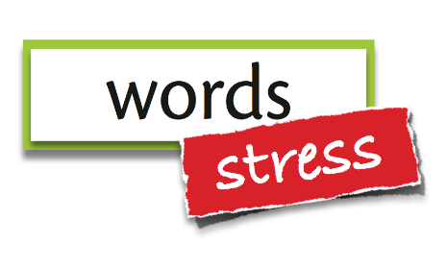

Four Effective Presentation and Teaching Delivery Techniques
Smile!
Use
Signposting!
Use word and sentence stress!
Use natural hand gestures!

Slide 23
Video 2: Definition and classification
Now watch video 2 again…
https://www.youtube.com/watch?v=EPfzJ9qaPcw
…and notice how well Mary delivers her talk by:
-smiling ☺ ☺
-using word and sentence stress (stressing key words in each sentence)
-using NATURAL hand gestures
-using signposting

Slide 24
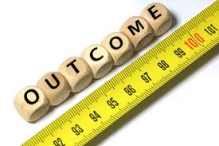
Intended Learning Outcomes
By the end of today’s lesson, you should be able to:
a. understand the importance of sentence stress and rhythm
in speaking and teaching
b. understand and apply the concept of chunking to teaching
c. explain why Comparison and Contrast are important in teaching
d. use a Comparison and Contrast structure in a 3-4 minute lesson
with clear, correct, and appropriate spoken English
e. use proper pronunciation, word and sentence stress, rhythm and
intonation in a brief lesson
f. use effective presentation delivery techniques, including smiling,
word and sentence stress, hand gestures and signposting

Slide 25
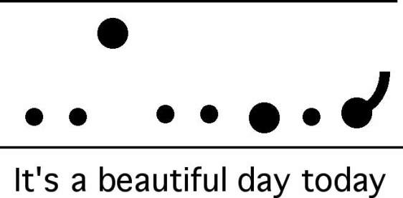
Prosodic features: Sentence Stress, Rhythm and Intonation

Slide 26

Sentence Stress & Rhythm
Look at the following sentences. Which words should you stress? Say the sentences and snap your fingers on the stressed words with a regular beat.
He’s been offered a job.
We’re sorry we’re late. We’ve been at a party.
I haven’t heard from Tom for a while.
I’m sure he could have found a better one than that.

Slide 27
Sentence Stress & Rhythm
Look at the following sentences. Which words should you stress? Say the sentences and snap your fingers on the stressed words with a regular beat.
He’s been offered a job.
We’re sorry we’re late. We’ve been at a party.
I haven’t heard from Tom for a while.
I’m sure he could have found a better one than that.

Slide 28
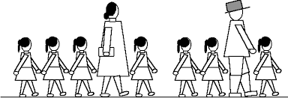
Sentence Stress & Rhythm
Underline the key syllable of each word in the passage below while reading it aloud. Try to make the stressed words stand out from the others. What happens to the words you didn’t stress?
I don’t need to stress every word when I speak. I only need to pronounce the key words right to get my meaning across. What I don’t emphasize becomes much shorter, quicker, and quieter. Already, I can begin to feel I’m speaking English better.

Slide 29
Sentence Stress & Rhythm
Practise saying the following text with accurate sentence stress.
I don’t need to stress every word when I speak. I only need to pronounce the key words right to get my meaning across. What I don’t emphasize becomes much shorter, quicker, and quieter. Already, I can begin to feel I’m speaking English better.

Slide 30
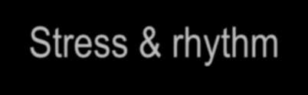
Stress and rhythm, and intonation
Stress and Rhythm
The most important words in a sentence are stressed - (nouns, verbs, adjectives, adverbs)
Sentence stress provides the rhythm of a sentence

Slide 31
Contrastive Stress
Practise the following dialogues with a partner. Think about where to put the stress.
1. | You live in Kowloon Tong, don’t you? No I work in Kowloon Tong.
2. | Are you Japanese? No, I’m Chinese.
3. | Your address is Flat 2B, 36 Nathan Road, right? No, it’s Flat 2C, 236 Nathan Road.
4. | Your address is Flat 2B, 36 Nathan Road, right? No, it’s Flat 2B, 56 Nathan Road.

Slide 32
Contrastive Stress
Read the conversation below and decide which word(s) in each line should be stressed. (The stressed words in the first 3 lines have been done already.)
Dave: I bought a really interesting book last week.
Andy: Last night?
Dave: No, last week. It’s about climate change.
Andy: Who wrote it?
Dave: Al Gore.
Andy: Oh, she’s great.
Dave: You mean he, don’t you?
Andy: Oh. Sorry. What does he say?
Dave: He says climate change is your fault!
Andy: My fault?!
Dave: Well, you do drive a big car, don’t you?
Andy: Don’t you?
Dave: No, I sold mine.
Andy: Well, I’ll never sell mine. It’s too comfortable.
Dave: Maybe you think that’s important, But I think the environment is more important.
Andy: The environment is important. But if you ask me, comfort is the most important.
Dave: You’re terrible!
Andy: No, you are!

Slide 33
Contrastive Stress
Practise the reading the following conversation two times with a partner. (One time you
are Dave and one time you are Andy.) Be sure to fully stress the highlighted words.
Dave: I bought a really interesting book last week.
Andy: Last night?
Dave: No, last week. It’s about climate change.
Andy: Who wrote it?
Dave: Al Gore.
Andy: Oh, she’s great.
Dave: You mean he, don’t you?
Andy: Oh. Sorry. What does he say?
Dave: He says climate change is your fault!
Andy: My fault?!
Dave: Well, you do drive a big car, don’t you?
Andy: Don’t you?
Dave: No, I sold mine.
Andy: Well, I’ll never sell mine. It’s too comfortable.
Dave: Maybe you think that’s important, But I think the environment is more important.
Andy: The environment is important. But if you ask me, comfort is the most important.
Dave: You’re terrible!
Andy: No, you are!

Slide 34

Intonation
Intonation is the rising or falling tone at the end of a sentence or question.

Slide 35
Stress and rhythm, and intonation
Listen to the stress, rhythm, and intonation of this poem.
Now you try it.
My name is Yon Yonson
I come from Wisconsin
I work in a lumber yard there
Everyone that I meet
When I walk down the street
Says "Hello! What's your name?”
And I say: (pause)
My name is Yon Yonson...
(repeat again and again)

Slide 36
Stress and rhythm, and intonation
Listen to the stress, rhythm, and intonation of this limerick.
Now you try it.
My name is Yon Yonson,
I come from Wisconsin
I work in a lumber yard there
Everyone that I meet
When I walk down the street
Says Hello What's your name?
And I say … (pause)
My name is Yon Yonson
(repeat again and again)

Slide 37
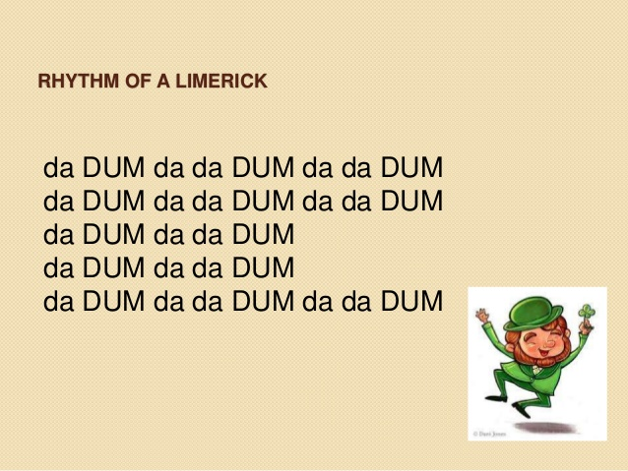

Slide 38

Limericks: (5-line poems with rhythm)
Read the following limerick aloud. Think about which words to stress and whether each line has rising or falling intonation. Practise saying it with accurate sentence stress, rhythm and intonation.
There was an odd fellow named Gus When travelling he made such a fuss He was banned from the train Not allowed on a plane And now travels only by bus

Slide 39
Limericks: (5-line poems with rhythm)
Try reading this aloud with appropriate word stress, rhythm and intonation.
There was an odd fellow named Gus When travelling he made such a fuss He was banned from the train Not allowed on a plane And now travels only by bus.

Slide 40
Limericks: (5-line poems with rhythm)
Read the following limerick aloud. Think about which words to stress and whether each line has rising or falling intonation.
My neighbor came over to say Although not in a neighborly way That he'd knock me around If I didn't stop the sound Of the rock n’ roll music I play

Slide 41
Limericks: (5-line poems with rhythm)
Try reading this aloud with appropriate word stress, rhythm and intonation.
My neighbor came over to say Although not in a neighborly way That he'd knock me around If I didn't stop the sound Of the rock n’ roll music I play

Slide 42
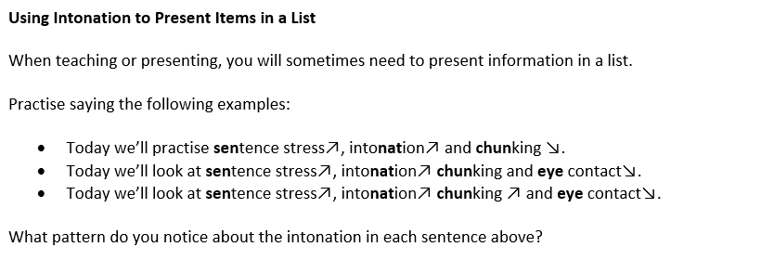
Activity: Complete the rule about intonation when presenting lists:
When presenting a list in English, all items in the list will have rising intonation except the ________ one, which will ________.

Slide 43
Make lists of the following. Make sure there are the correct number of items in each list.
 | Your lists
Items you need to buy (3 items)
Countries you hope to visit (4 items)
Things you must do this week (5 items)
Practise presenting the items in your lists with appropriate stress and intonation. (Be prepared to present your lists to the class with proper intonation according to the rule about presenting items in a list.)

Slide 44
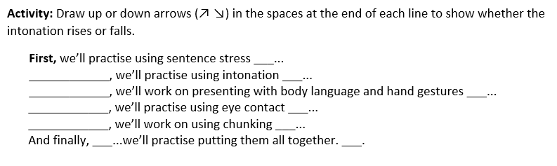
Using Intonation when presenting lists
First Then Next After that

Slide 45
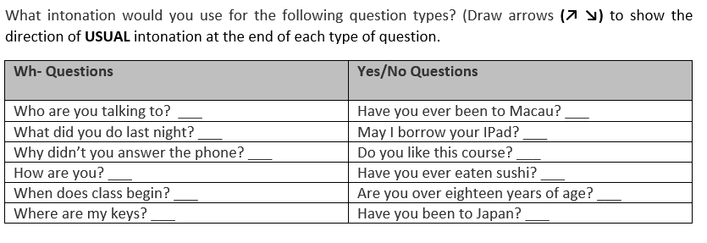
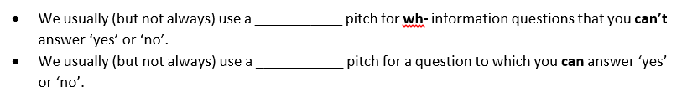
Intonation in Questions

Slide 46
Intonation
Use up or down arrows (↗ ↘) to mark the appropriate intonation at the end of the following questions.
‘So why give an oral presentation ___? Why not simply provide a report ___? Why not simply write a paper ___? Is there something which an oral presentation can do which a written report cannot ___? ‘

Slide 47
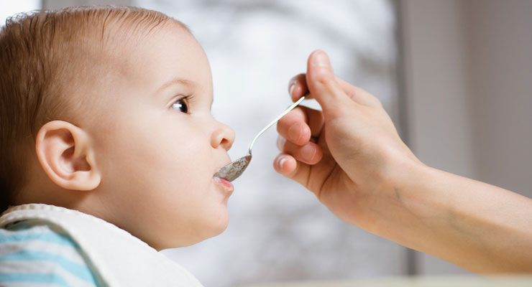
Presentation Technique: Chunking
Presenting information to an audience is similar to feeding a baby. It should be done gradually so that the ‘food’, or information, is received comfortably. If information is given too quickly, the audience cannot ‘digest’ it easily, which may cause confusion or problems in understanding what you are talking about. Using chunking in your presentation can prevent this problem.
Look at the following famous line from William Shakespeare’s play, Hamlet.
‘To be or not to be; that is the question.’
Where would you naturally pause when delivering this sentence?

Slide 48
Chunking
Try these possible ways to say this sentence with chunking:
-‘To be / or not to be; / that / is the question.’
-‘To be / or not to be; / that is the question.’
-‘To be / or not / to be; / that / is the question.’
Which one feels most comfortable to you?

Slide 49
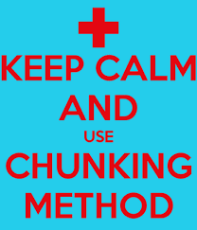
Chunking
Practise saying these well-known English proverbs with a partner using chunking:
Decide where the pauses [ / ] should be.
Decide which word in each chunk should be stressed.
Use appropriate intonation.
-"Two wrongs don't make a right.“
-"The pen is mightier than the sword.“
-"When in Rome do as the Romans.“
-"People who live in glass houses should not throw stones."

Slide 50
Chunking
Decide where the pauses [ / ] should be.
Decide which word in each chunk should be stressed.
Use appropriate intonation.
Possible ways:
-"Two wrongs / don't / make a right.“
-"The pen / is mightier / than the sword.“
-"When in Rome / do / as the Romans do.“
-"People who live / in glass houses / should not / throw stones."

Slide 51
Chunking
Chunking means saying words in groups, not individually. Saying each word individually sounds unnatural.
Instead, chunks of words should be spoken with natural stress and intonation, and with a pause after each chunk.

Slide 52
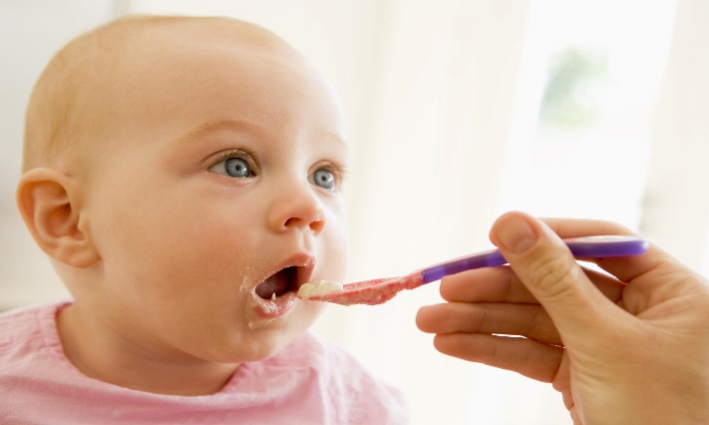
Practise the first part of the CPI video from last week with a partner!
‘CPI is defined / by the Bureau of Labor Statistics / as a measure / of the average change over time / in the prices paid by urban consumers / for a market basket / of consumer goods and services. / Now, / what does that mean? / That means, / that it measures how much, / more or less, / you pay for things you buy / as an urban consumer.’

Slide 53
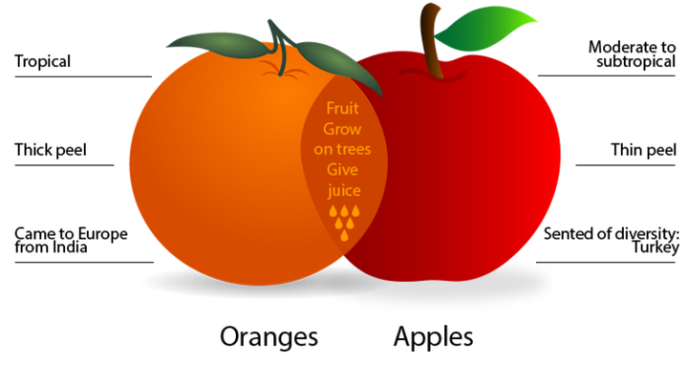
Teaching Strategy 2:
Comparison and Contrast

Slide 54

Quick Compare and Contrast Speaking Activity
Choose 2 or 3 of the following and compare and contrast them with your partner. Then switch roles.
Pens vs pencils
Piano vs guitar
Shopping in stores vs online shopping
Cantonese vs Sichuan food
Tea vs coffee

Slide 55
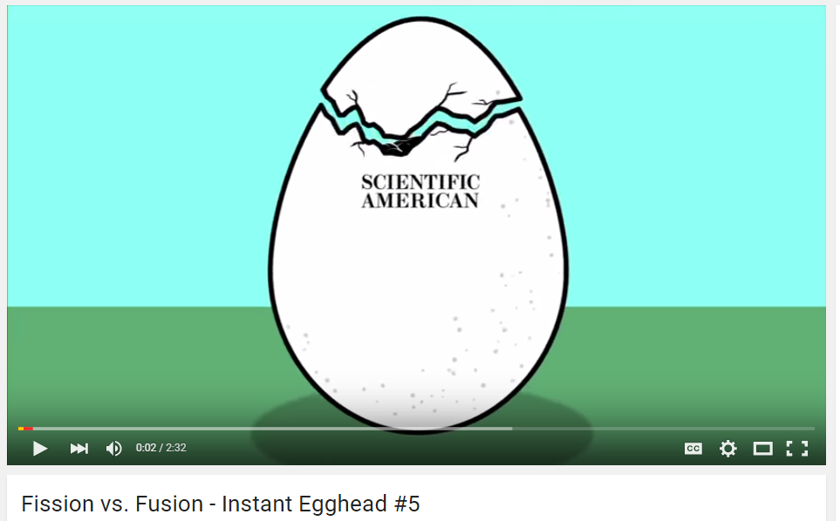
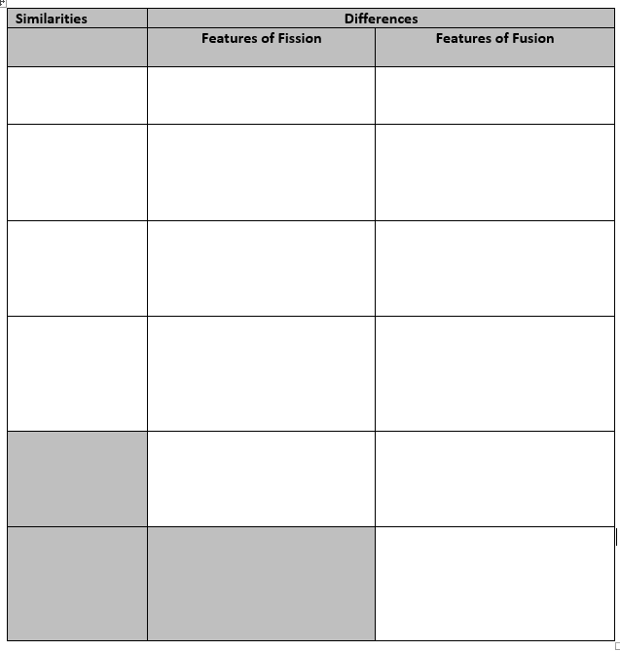
While listening to the video about fission and fusion, fill out the similarities and differences in the chart below:
https://www.youtube.com/watch?v=3rn339v_Q-w

Slide 56
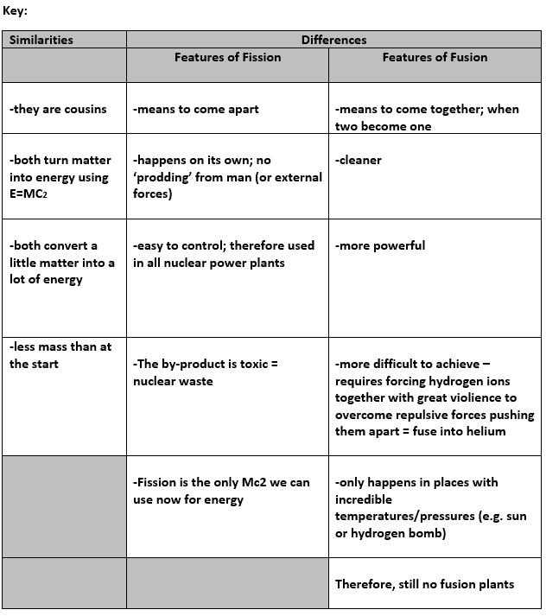

Slide 57
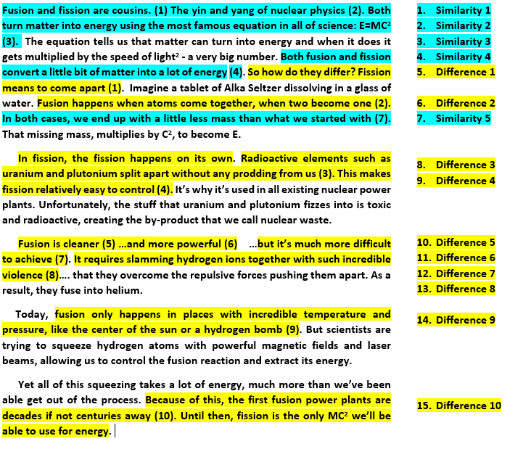
Notice the structure of this ‘Compare and Contrast’ lesson
https://www.youtube.com/watch?v=3rn339v_Q-w

Slide 58
Chunking
Use [/] marks to divide the first several lines of the first video.
Take turns speaking in sense groups to each other.
Fusion and fission are cousins. The yin and yang of nuclear physics. Both turn matter into energy using the most famous equation in all of science: E=MC². The equation tells us that matter can turn into energy and when it does it gets multiplied by the speed of light² - a very big number.

Slide 59
Chunking
One possibility:
Fusion / and fission / are cousins. / The yin and yang / of nuclear physics. / Both / turn matter into energy / using the most famous equation / in all of science: / E=MC². / The equation / tells us / that matter / can turn into energy / and when it does / it gets multiplied / by the speed of light² / - a very big number.

Slide 60
Comparing and Contrasting
When speaking about similarities and differences, there are two common approaches. In each approach, you should first introduce the general topic.
Approach One – One by One
introduce your topic
talk about the similarity, then the second similarity, then the third similarity, and so on. Give examples.
When you have finished with the similarities, you can talk about the first difference, the second difference, etc...
Approach Two - Alternate
introduce your topic
talk about one similarity
talk about one difference
talk about another similarity
talk about another difference until you have covered all the similarities you wish

Slide 61

Prepare and ‘Teach’ Your Own C&C Mini-lesson
Prepare a 3-minute ‘compare and contrast’ mini-lesson for a partner. You may choose 2 similar but easily confused concepts from your own discipline (e.g. fission vs fusion). You may instead compare and contrast the research of two similar but different famous researchers in your field of study (e.g. Einstein vs Newton).
Be sure to:
Make notes of what you will say (not full sentences).
Organize your talk with a logical compare and contrast structure.
Smile, use natural hand gestures and chunking.
Teach it to your partner with proper pronunciation, word stress, sentence stress, intonation.
Change roles with your partner afterwards.

Slide 62
homework
Do at least one hour of OPTIMUS work; refer to and complete the OPTIMUS homework reflection form on pp 34-36 in Course Booklet, Lesson 3. Submit this in Lesson 4. (Compulsory)
Refer to the recommended on-line sites and apps from Lesson 1 for pronunciation and stress and do more practice.
Record or video yourself a few times teaching a simple concept with definition and classification from your discipline with the strategies you have learned today and last week. Critically analyze your recordings/videos and look for ways to improve them.

